Slide 1


SEMINAR AND PROJECT PRELIMINARY
(EE451)
GESTURE BASED COMMUNICATION SYSTEM FOR DUMB DEAF
GROUP MEMBERS :
MUHAMMED SHABEER
MUHAMMED SHAMEER
NIKHIL BABY
SAURAV M V
GUIDED BY
SARIN C R
ASSISTANT PROFESSOR
EEE DEPARTMENT
VJEC
DEPARTMENT OF ELECTRICAL AND ELECTRONICS ENGINEERING
VIMAL JYOTHI ENGINEERING COLLEGE, CHEMPERI

Slide 2
CONTENTS
Project objective
Basic working
Components used
Methodology
Block diagram
Time and cost
Conclusion

Slide 3
OBJECTIVE
It is observed that people having Speech or Listening Disability face many communication problem while interacting with other people.
Also it is not easy for people without such disability to understand what the opposite person wants to say with the help of the gesture he or she may be showing.
In order to overcome this barrier we made an attempt of creating an application which will detect these gesture and provide a textual output enabling a smoother process of communication.
Basic Gesture Based Communication for Deaf and Dumb is an Application which converts Input Gesture to Corresponding text.

Slide 4
BASIC WORKING
The dumb and deaf person can use gestures and the message is converted to text and shown through mobile in text and audio.
The other person can simply use their voice on and the mobile would convert it into text
There is a lot of research being done on Gesture Recognition. This Project will help the users ie the deaf and dumb people to communicate with other people without having any barriers due to their disability.

Slide 5
Components used
Flex sensor
Arduino nano
Bluetooth sensor
smartphone

Slide 6
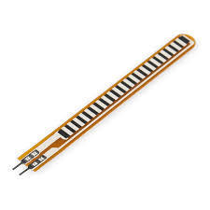
Flux sensor
It is a flex sensor which is 2.2 inches in length. This sensor works by bending the sensor itself. As the sensor is being flexed or bent, the resistance across the sensor increases. The greater the angle of bending, the greater the resistance.

Slide 7
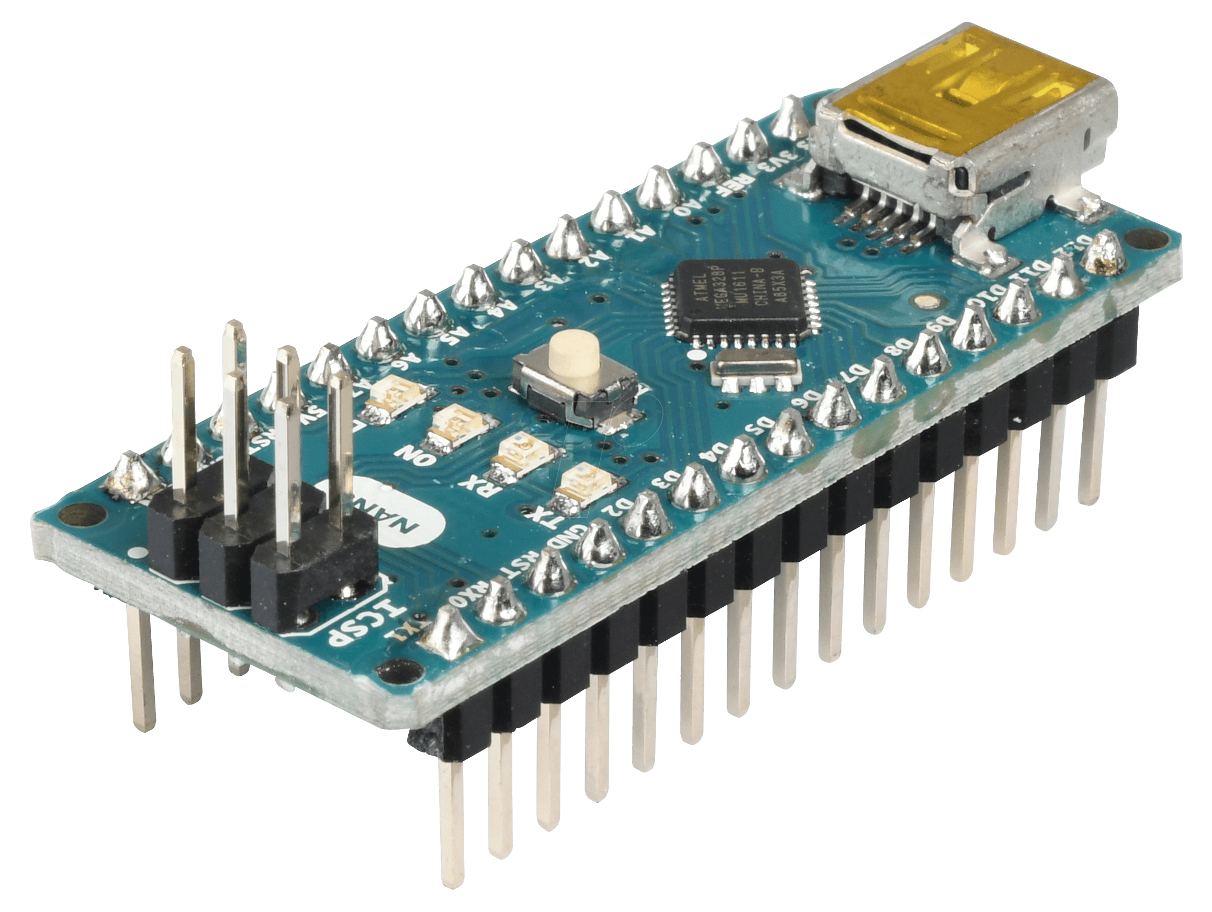
Arduino nano
Arduino Nano is a surface mount breadboard embedded version with integrated USB. It is a smallest, complete, and breadboard friendly. It has everything that Diecimila/Duemilanove has (electrically) with more analog input pins and onboard +5V AREF jumper. Physically, it is missing power jack.

Slide 8
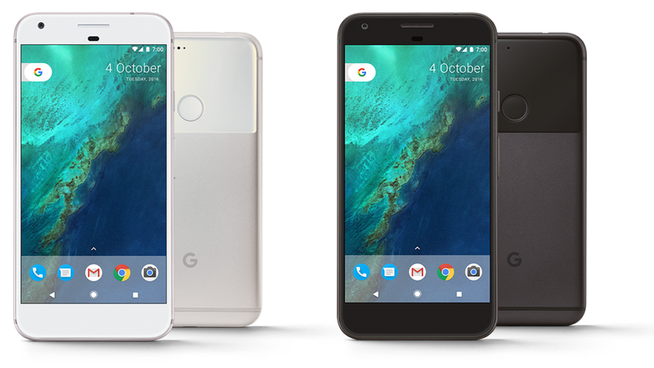
Android smartphone
An Android phone is a powerful, high-tech smartphone that runs on the Android operating system (OS) developed by Google and is used by a variety of mobile phone manufacturers. Pick an Android mobile phone and you can choose from hundreds of great applications and multitask with ease

Slide 9
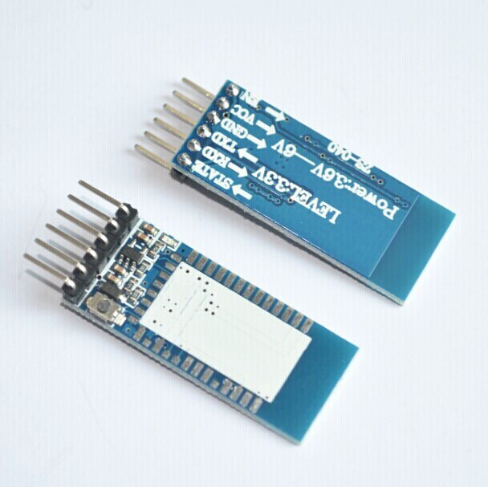
Bluetooth sensor
A Bluetooth technology is a high speed low powered wireless technology link that is designed to connect phones or other portable equipment together. ... Wireless signals transmitted with Bluetooth cover short distances, typically up to 30 feet (10 meters). It is achieved by embedded low cost transceivers into the devices.

Slide 10
Methodology
The proposed system aims to give voice to voiceless people with the help of smart gloves.
In this the flux sensor are used for sign language for each sign the respective voice output is obtained via MP3 module text message is obtained by smartphone display through hand gesture movement.
gesture of the palm can be captured by the flux sensors can measure the bend of the five fingers when making a sign.
For each sign the voice will be recorded and stored in Sd card.
When the user performs a gesture the signs are captured by the microcontroller which converts the analog signals to digital values through its 8-channel ADC.
And gives the corresponding sound output and text.

Slide 11
GESTURE TO TEXT AND AUDIO CONVERSION
SMARTPHONE
BLUETOOTH SENSOR
DISPLAY
5V SUPPLY
ARDUINO
SPEAKER
FLUX SENSOR

Slide 12
This module is a wearable device consisting of a glove with five flex sensors, arduino nano and Bluetooth sensor.
The flux sensor detects the gestures and the Arduino process them and through Bluetooth sensor the text is sent to smartphone.
Through the smartphone display the text output is shown and through the speaker of the phone the audio output is provided

Slide 13
AUDIO TO TEXT CONVERSION
SMARTPHONE
SPEAKER
(OUTPUT)
GOOGLE API
(PROCESSING)
MIC
(INPUT)

Slide 14
This module is an Android App, with Google API. It converts a Speech into text and displays on Mobile Screen. This modules functionality is limited to English language. It also works in offline mode

Slide 15
LITERATURE SURVEY
There are many systems that helps the deaf and dumb people to communicate with with others.
But currently there is no effective system that provides a two communication between them and normal people.
In this project the sign language of deaf and dumb people is converted to an audio and text output and can be displayed through a smart phone.
At the same way communication between normal people to deaf people can be enabled by converting speech to audio and text .

Slide 16
DETAILS OF WORK DONE IN PRELIMINARY PHASE
PHASE 1
August 2019
Formation of group
PHASE 2
Formulation of idea
Presented on the zeroth review (2-September- 2019)
Identification suitable design to be implemented.
PHASE 3
Rough sketching of the model
Presented on the first review ( 2-November-2020)
PHASE 4
Rough sketching of the design.

Slide 17
DETAILS OF WORK PROGRESS IN THE CURRENT SEMESTER
Started to purchase components.
App development
Detailed study on sign languages.

Slide 18
Time and cost
Equipment | No of set | Price
Gloves | 2 | 500/-
Flux sensor | 10 | 2500/-
Bluetooth sensor | 1 | 400/
Battery | 2 | 100/-
Arduino nano | 2 | 1000/-
Smartphone | 1 | 5000/-
App development |  | 5000
TOTAL |  | 14,500

Slide 19
WORK PLAN
Key Action Step | Timeline | Time Duration | Expected Outcome
Preliminary work | Jan 13 – Jan 28 | 1 week | Various journals and online sites
Design of prototypes | Jan 29 – Feb 6 | 1week | Design of project including circuit diagram , designing, component selection
Component purchase | Feb 24 – March 4 | 2 days | Purchasing of various component including fingerprint sensor
Aurdino programming and Framework | March 5 – March 8 | 3 days | Framework and aurdino programming
Hardware developing and verifying | March 3 - March 8 | 2 days | Hardware developing , verification and testing

Slide 20
CONCLUSION
This project include the use of Arduino, Flex sensor to convert hand gesture into audible speech as well as an android application is used to convert speech to text which will be displayed on mobile screen.
This project aims to lower the barrier of communication between mute and deaf community with the normal world. This project will be used by dump and deaf people as Assistant for themselves.

Slide 21
REFERANCES
[1] Embedded Based Hand Talk Assisting System for Deaf and Dumb International Journal of Engineering Research & Technology (IJERT) IJERT ISSN: 2278-0181 Vol. 3 Issue 3, March – 2014
[2] Interactive Glove 1dipesh Patil, 2 Siddhesh Sahane, 3vinayak Soma, 4ajish Francis Electronics and Telecommunication Engineering Department, International Journal of Scientific Engineering and Technology (ISSN : 2277-1581) Volume 2 Issue 5, pp: 336-341
[3] Talking Glove- A Boon for the Deaf, Dumb and Physically Challenged ISSN: 2278 – 909X International Journal of Advanced Research in Electronics and Communication Engineering (IJARECE) Volume 4, Issue 5, May 2015
[4] A Preview Paper on Hand Talk Glove International Journal for Research in Applied Science & Engineering Technology (IJRASET) Volume 3 Issue IV, April 2015 IC Value: 13.98 ISSN: 2321-9653

Slide 22


